Slide 1
Other Keys

Slide 2
Super Key
A Super key is any combination of fields within a table that uniquely identifies each record within that table.
Super key stands for superset of a key.
Super Key are:
  EmpNo, Name
  EmpNo,Name,Job
  EmpNo,Name,Job,Deptno

Slide 3
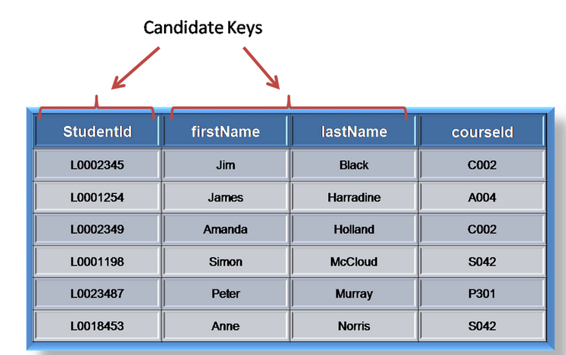
Candidate Key
A candidate is a subset of a super key.
A candidate key is a single field or the least combination of fields that uniquely identifies each record in the table.

Slide 4
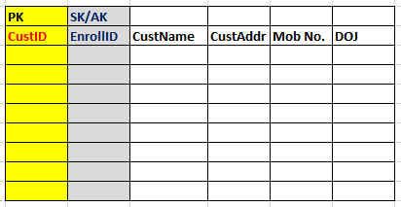
Secondary Key or Alternate Keys
A table may have one or more choices for the primary key.
One is selected as the primary key.
Those not selected are known as secondary keys or alternative keys.

Slide 5
Composite Primary Key
The combination of values cannot repeat
Individually values can repeat.
Individually values cannot be null.
Example
First_Attempt_Marks table has Rollno, Subject & Marks as the columns. Here Rollno & Subject together will make one composite primary key

Slide 6
Composite Keys
Composite Keys can be:
  Composite Primary Key
  Composite Unique Key
  Composite Foreign key

